Slide 1
Understanding the Human being as Co-existence of the Self and the Body

Slide 2
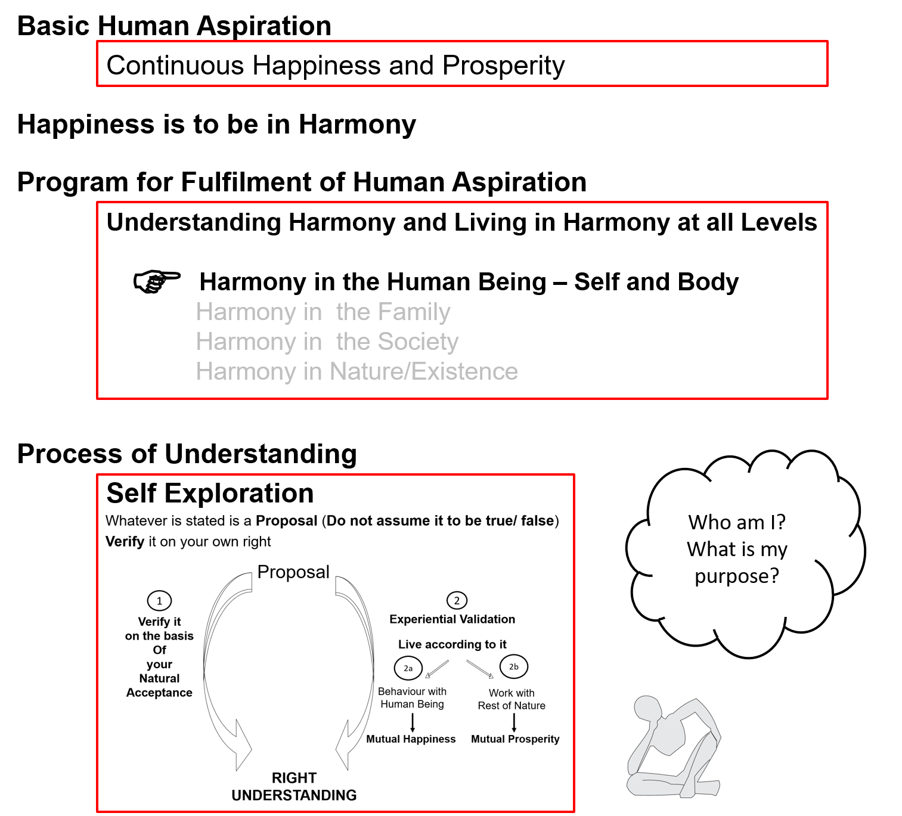

Slide 3
Human Being | Self | Body
Need | Happiness (e.g. Respect) | Physical Facility (e.g. Food)
In Time | Continuous | Temporary
In Quantity | Qualitative (is Feeling) | Quantitative (Required in Limited Quantity)
Co-existence
Are these needs are of different types or of same type?
Are both types of needs important / Do we want fulfillment of both types of needs?
Are we working to fulfill both types of needs?
What is the priority between the needs of the Self & the needs of the Body?

Slide 4
Human Being | Self | Body
Need | Happiness (e.g. Respect) | Physical Facility (e.g. Food)
In Time | Continuous | Temporary
In Quantity | Qualitative (is Feeling) | Quantitative (Required in Limited Quantity)
Fulfilled By | Right Understanding & Right Feeling | Physio-chemical Things
Co-existence
The needs of the Body can not be fulfilled by Right Understanding, Right Feelings alone
The needs of the Self can not be fulfilled by Physio-Chemical Things
Both type of needs have to be understood separately
Both type of needs have to be fulfilled separately
In living, what is the priority?
How much time & effort is spent for right understanding & right feelings?
How much time & effort is spent for physical facility?

Slide 5
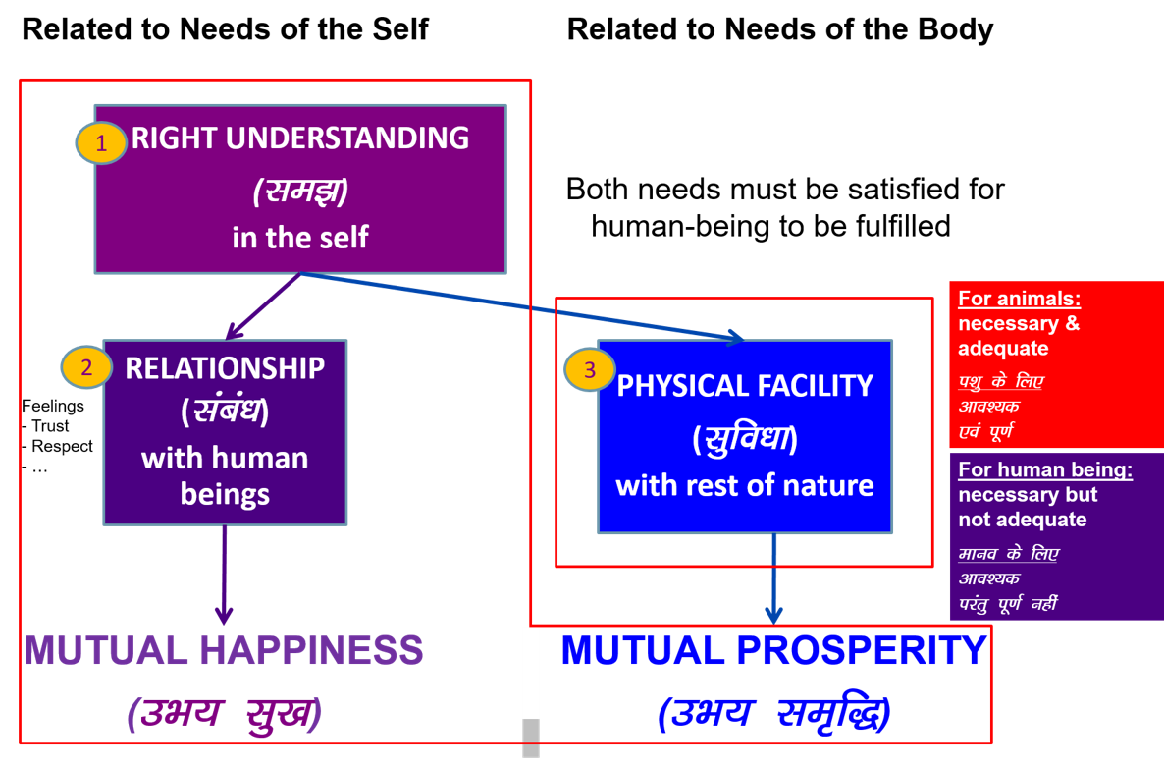

Slide 6
Co-existence
Human Being | Self | Body
Activity | Desire, Thought, Expectation… | Eating, Walking…

Slide 7
Co-existence
Human Being | Self | Body
Response | Knowing, Assuming*, Recognising, Fulfilling | Recognising, Fulfilling
* Assuming or Accepting

Slide 8
Human Being | Self | Body
 | Consciousness | Material
Co-existence

Slide 9
Sum Up
Human being is a co-existence of Self and Body
Self is consciousness. Its needs are feelings in consciousness (like happiness) and these needs are fulfilled by activity of consciousness, i.e. Right Understanding & Right Feeling
Body is material. Its needs are material (like food) and these needs are fulfilled by material, i.e. Physio chemical things
The needs of consciousness can not be fulfilled by material
The recognition & fulfillment in the self is on the basis of knowing, assuming
If the assumption is based on knowing, the assumption is right and the recognition & fulfillment is correct → definite conduct
If the assumption is without knowing, the assumption may or may not be right , so the recognition & fulfillment is uncertain → indefinite conduct

Slide 10
Understanding Harmony in the Self

Slide 11
Activities of Self
1.
2.
3. | Desire
4. | Thought
5. | Expectation
Imagining
Analysing-Comparing
Selecting
Self
Imagination
Information
Body j
Behaviour
Work

Slide 12
Source of Motivations for our Desires - Its Implications
1.
2.
3. | Desire
4. | Thought
5. | Expectation
Imaging
Analysing-Comparing
Selecting-Tasting
Self verification on the basis of Natural Acceptance
Self
3
Preconditioning
1
Enslavement
Self-organised
Imagination
Information
Body
2
Sensation
Behaviour
Work
Enslavement

Slide 13
The Body as an Instrument of the Self

Slide 14
Self Body
Consciousness |  | Material
INFORMATION
Instruction
Sensation

Slide 15
Self Body
Consciousness |  | Material
I am |  | My body is
I want to live |  | My body is used as an instrument
I want to live with continuous happiness |  | Physical facility is required for nurturing, protection and right utilization of the body
To understand and to live in harmony at all levels of being (from self to entire existence) is my program of action for continuous happiness |  | Production, protection and right utilization of physical facility is a part of my program
I am the: Seer, Doer, Enjoyer (Experiencer) |  | I use the body as an instrument for fulfillment my program
INFORMATION
Instruction
Sensation

Slide 16
I am the Seer
“Seer” means the one that sees / understands
e.g. If you are given something in your hand and you conclude that it is a pen, it is not your eyes that concluded this. It is you that concluded this. The Self sees via the eyes – the eyes don’t see themselves
Like that all the 5 senses are just the instrument that enable the Self to see something outside
Just like you see outside, you can also see ‘within’, without using the body for sensation
e.g. You can ‘see’ that you are feeling happy, getting angry...
Thus, the Self ‘sees’ or understands, sometimes with the help of the body, sometimes without the help of body
The Body is used as an instrument

Slide 17
I am the Doer
“Doer” means the one that does, who takes decision to do
I am the one who decides. I decide what to do, what not to do...
I may or may not use the body to do – what I think of is my decision. I do that thinking within myself (there is no role of the body in this)
If required, the body is used to express my decision
The Body is used as an instrument

Slide 18
I am the Enjoyer (Experiencer)
“Enjoyer” means the one that experiences happiness / unhappiness
I am the one that feels enthusiastic or depressed. I am the one that feels angry or delighted...
I am the enjoyer, the experiencer
The Body is used as an instrument

Slide 19
Self Body
The Self is
central to human existence
The Body is
an instrument of the Self

Slide 20
Sum Up
Human Being is co-existence of Self and Body
The Self is the seer, doer and enjoyer – it is central to human existence
The need of the Self is continuous happiness
For this, the program of the Self is:
To understand harmony &
To live in harmony
Production, protection and right utilization of physical facility is a part of my program.
The Body is an instrument of the Self
The transaction between Self and Body is only in the form of information
at all levels of being
As an individual human being
As a member of the family
As a member of society
As an unit in nature/existence

Slide 21
Harmony of the Self with the Body (Understanding Prosperity and Health)

Slide 22
Self Body (Instrument)
Consciousness |  | Material
Needs: Happiness, Prosperity → Continuity |  | Physical Facility
Needs & activities are continuous in time |  | Temporary in time
Self-regulation |  | Health
Feeling of responsibility toward the body – for Nurturing, Protection and Right Utilization of the Body |  | 1. Body acts according to I 2. Parts of the body are in harmony (in order)
Food… Clothes, Shelter... Instruments…
INFORMATION
Instruction
Sensation
The required physical facility can be recognised
along with the required quantity
The quantity of food… required for nurturing the body – is it limited or unlimited?
Clothes, shelter… for protection of the body – is it limited or unlimited?

Slide 23
Self Body (Instrument)
Consciousness |  | Material
Needs: Happiness, Prosperity → Continuity |  | Physical Facility
Needs & activities are continuous in time |  | Temporary in time
Self-regulation |  | Health
Feeling of responsibility toward the body – for Nurturing, Protection and Right Utilization of the Body |  | 1. Body acts according to I 2. Parts of the body are in harmony (in order)
Food… Clothes, Shelter... Instruments… Required Required Required in a in limited in limited limited quantity quantity quantity
INFORMATION
Instruction
Sensation
Physical Facility is required to to keep the body in good health,
so that right utilisation of the body can be ensured
i.e. physical Facility is required only for
nurturing, protection and right utilisation of the body
If we can see that, the physical facility for
nurturing, protection and right utilisation of the body
is required in a limited quantity,
then we can understand the meaning of prosperity

Slide 24
Harmony of the Self with the Body = Self-regulation (feeling of responsibility toward the body) in the Self and Health in the Body
Other than these 3 (Nurturing, Protecting and Right Utilization of the Body), what would you need PF for?
The outcome of putting in so much time & effort in only PF – and it has only this much utility
Have you been able to make an assessment of your need for PF?
Are you able to see whether you have more than what your needs are?
Ex: Find out – how much PF is required; how much PF is available; are you prosperous or deprived?

Slide 25
Prosperity
Prosperity – The feeling of having / producing more than required Physical Facility
Identification of required physical facility (including the required quantity)
– with right understanding
Ensuring availability/ production of more than required physical facility
– with right skills
A prosperous person thinks of right utilisation, nurturing the other

Slide 26
In a previous session, we had seen that we can observe two categories of human beings
Lacking physical facility, unhappy deprived
Having physical facility, unhappy deprived
While we want to be –
Having physical facility, happy prosperous
Now we can see that if the identification of required physical facility is missing, then one can only shift between category 1 & category 2
This is possible only with
a- the right identification of required physical facility and
b- availability / production of more than required physical facility

Slide 27
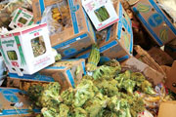
Misunderstanding – There is a Shortage of Physical Facility
Data: Of the 4.2 billion tons of food produced, more than 1 billion tons of food is lost or wasted every year, UN-backed report finds (11 May 2011)
About a third of all the food produced for human consumption each year – or roughly 1.3 billion tons – is lost or wasted, according to a new study commissioned by the United Nations Food and Agriculture Organization (FAO)
Global Food Production is 6 times requirement
Global Food Wastage is 1/3rd of production
Wastage is enough to feed 1300 crore people/year
Have we understood human needs?
Have we understood right utilisation?
Is it a question of right understanding?
It is a question of right education-sanskar

Slide 28
Program for Fulfillment of Feeling of Self-regulation
Self-regulation in the Self : Feeling of responsibility toward the body – for Nurturing, Protection and Right Utilization of the Body
Program for Fulfillment of Feeling of Self-regulation
1a. Intake 1b. Daily routine
2a. Labour 2b. Exercise
3a. Balancing internal & 3b. Balancing breathing of body
external organs
of body
4a. Medicine 4b. Treatment
Health in the Body
1. Body acts according to Self
2. Parts of the body are in harmony (in order)

Slide 29
Sum Up
Human Being is a co-existence of Self and Body
The Self is central to human existence; Body is an instrument of the Self
The transaction between Self and Body is only in the form of information
Physical Facility is required, in a limited quantity, for Nurturing, Protection & Right Utilisation of the Body
Prosperity = Feeling of having / producing more than required physical facility
Identification of required physical facility (including the required quantity) – with right understanding
Ensuring availability/ production of more than required physical facility – with right skills
The Self and the Body are in Harmony when there is a feeling of Self-regulation in the Self and Health in the Body
Self-regulation = Feeling of responsibility toward the body – for Nurturing, Protection and Right Utilization of the Body
Health = The body acts according to Self and parts of the body are in harmony (in order)

